Slide 1
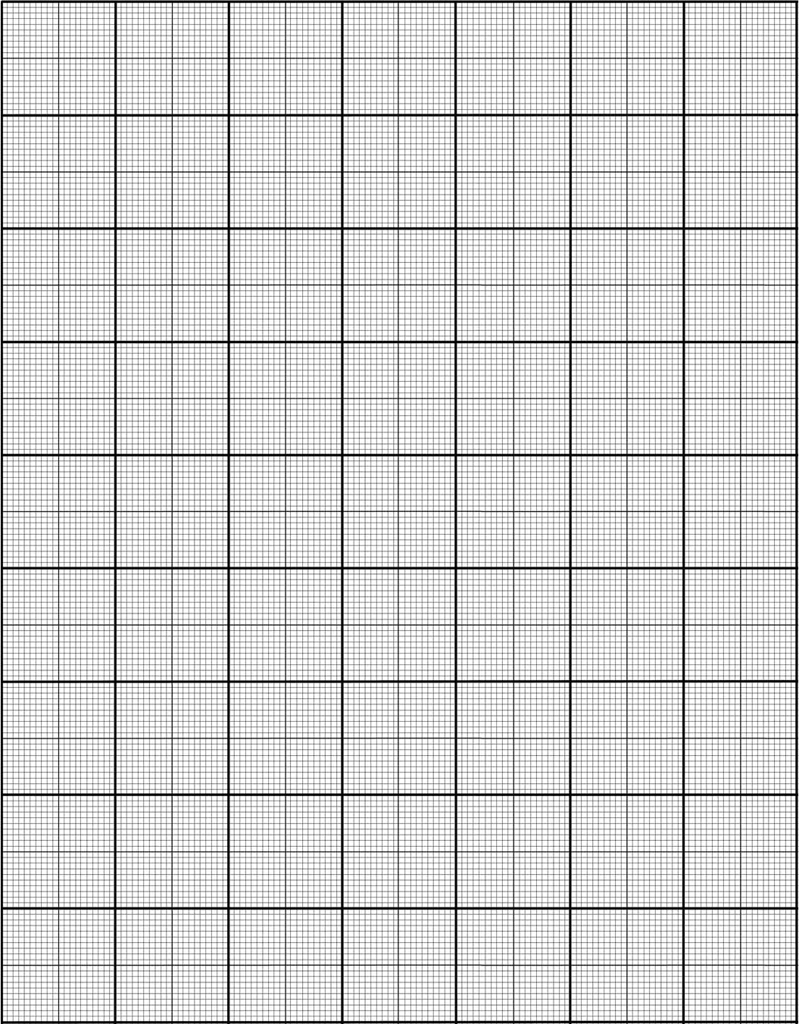
Line Segment Home Learning
1. For each of the lines below, calculate a) the midpoint b) it’s length
y
7
B
6
5
4
3
A
2
C
1
K
E
D
-5
-4
-3
-2
-1
0
1
2
3
4
5
-1
-2
-3
F
G
-4
-5
H
J
-6
-7

Slide 2
2. Calculate i) the midpoint, and ii) the length of the line joining the two points below.
(3, 6) and (5, 10) b) (0, 1) and (4, 3)
c) (-3, 2) and (3, 2) d) (-8, -7) and (4, 9)
EXTENSION:
3. One point on a line, the length of the line and one half of the co-ordinates of the end point of the line are given below. Calculate the value of a.
(1, 1) (4, a) line length = 5
(3, 8) (10, a) line length = 6
(9, 1) (a, 6) line length = 12
(a, -3) (-2, -7) line length = 3

